Slide 1
DARRELL & DAWN RITCHIE

Slide 2
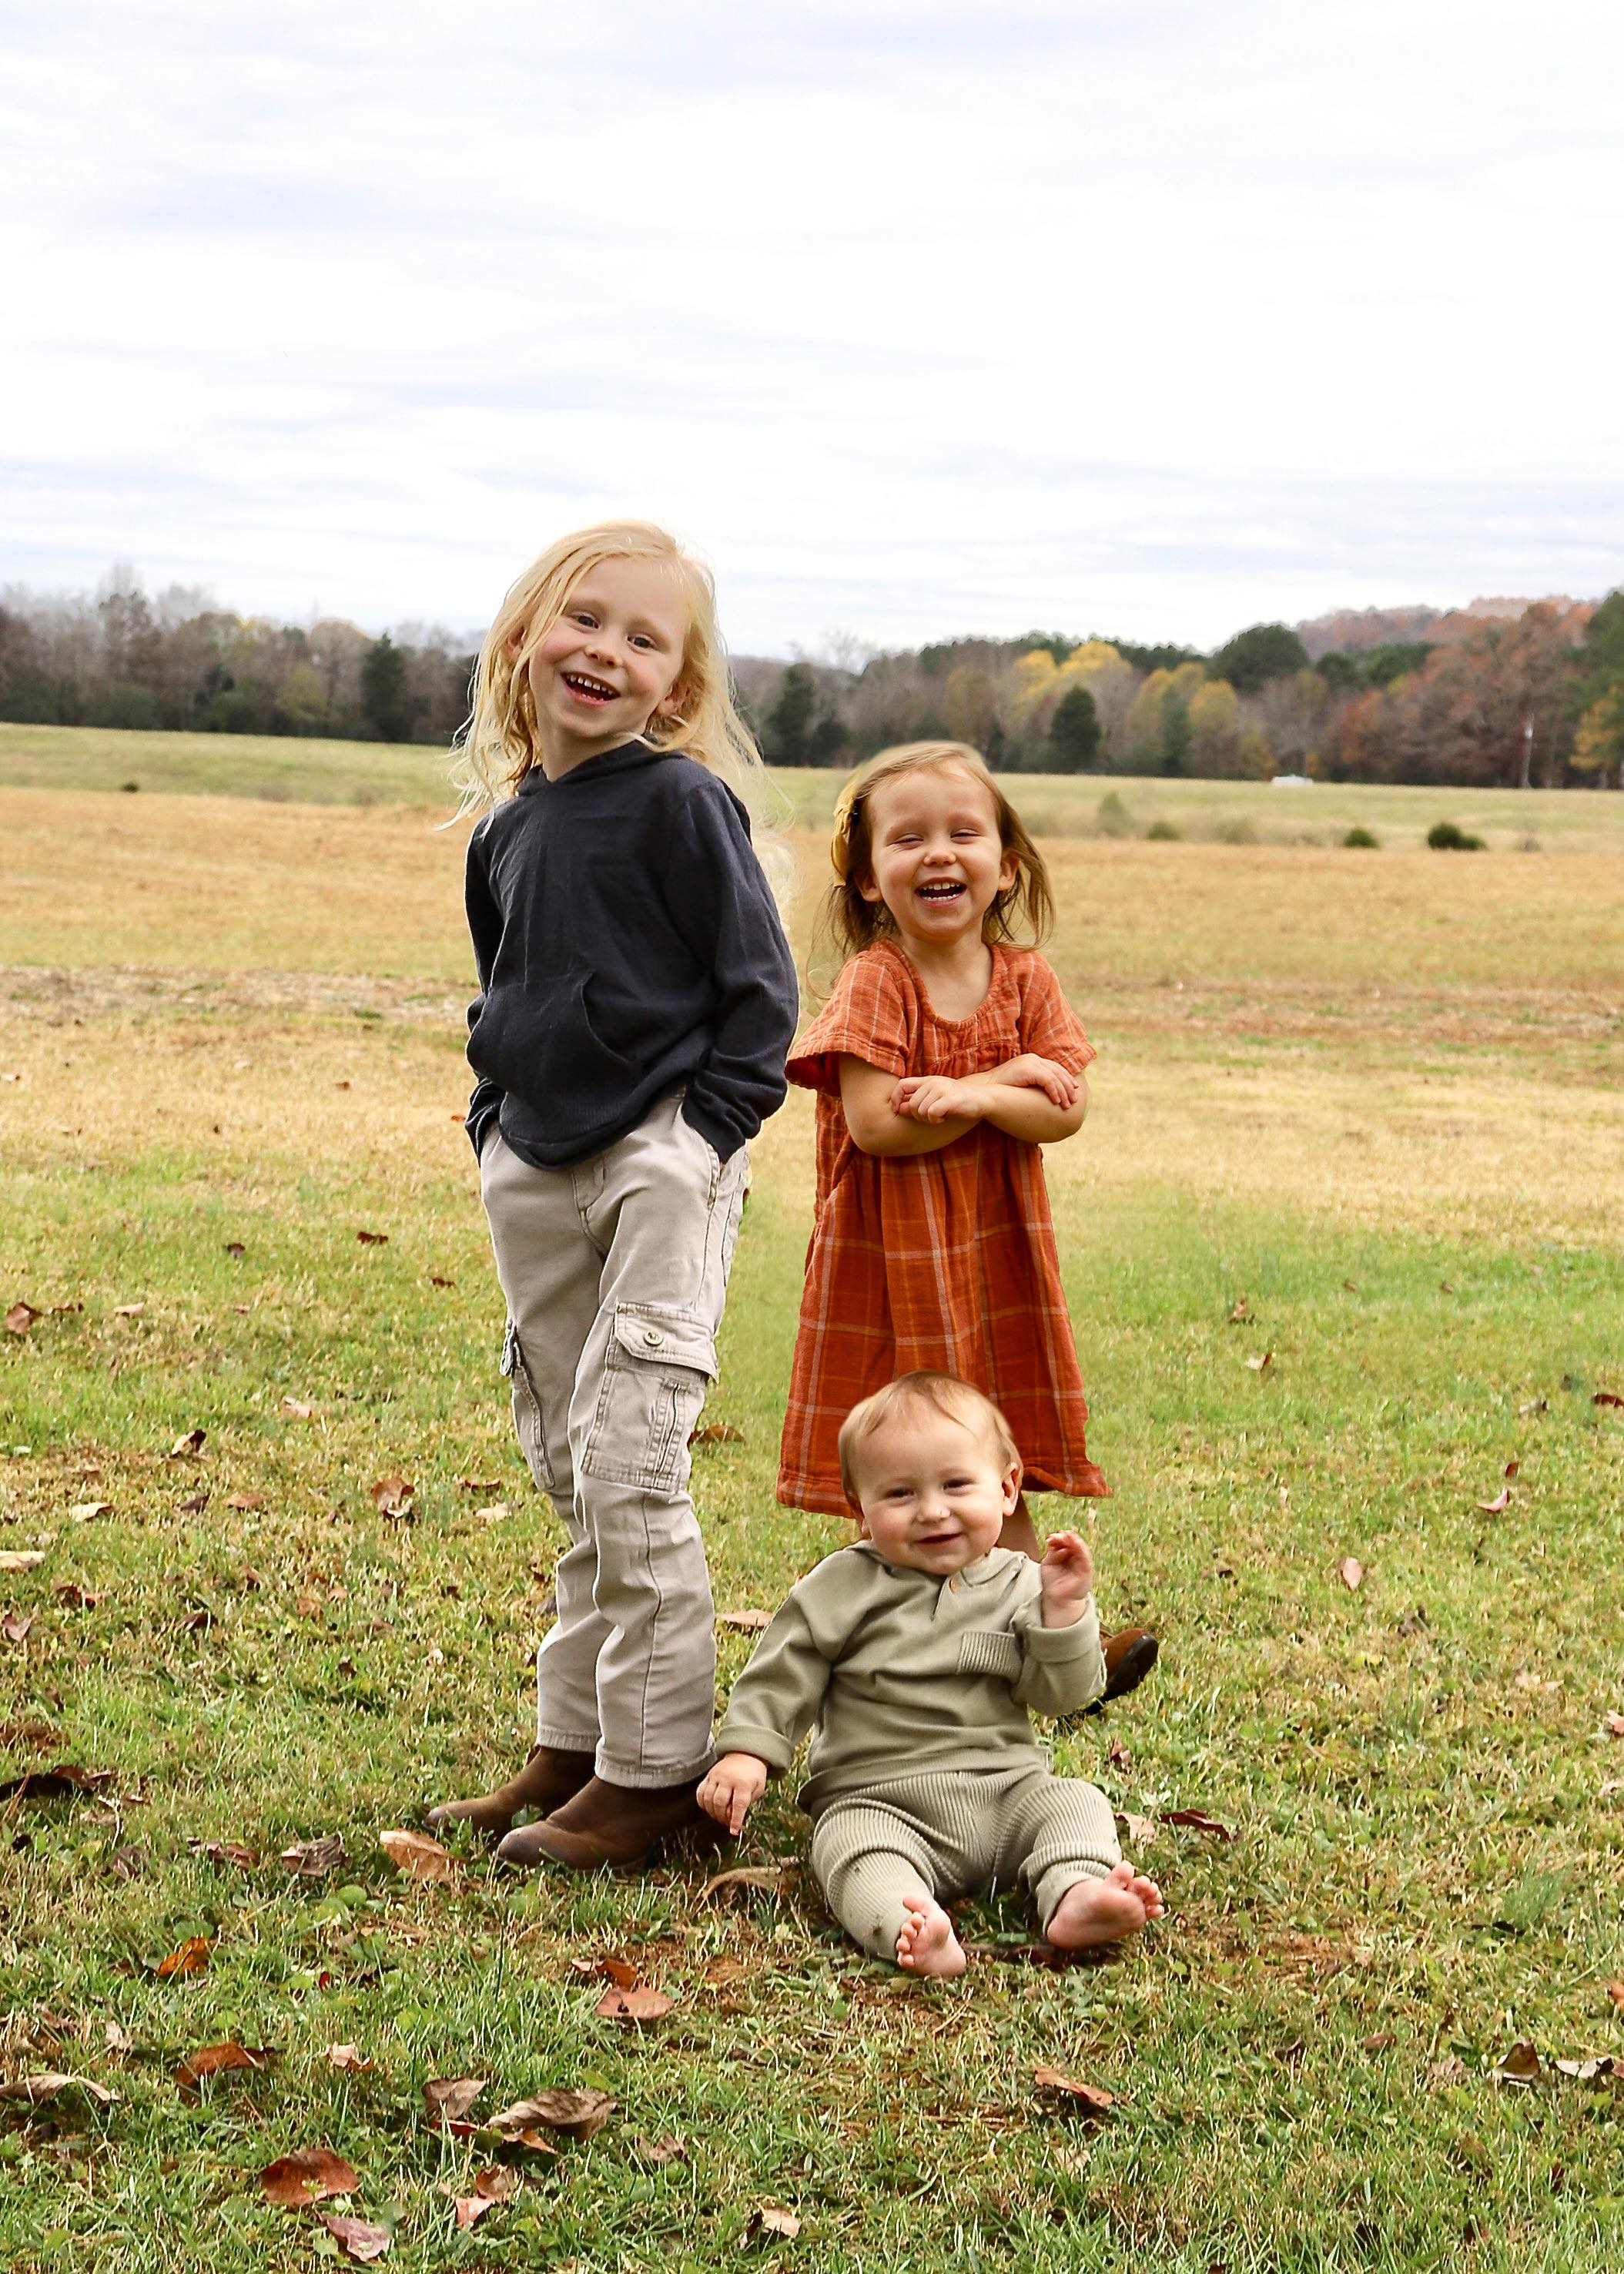
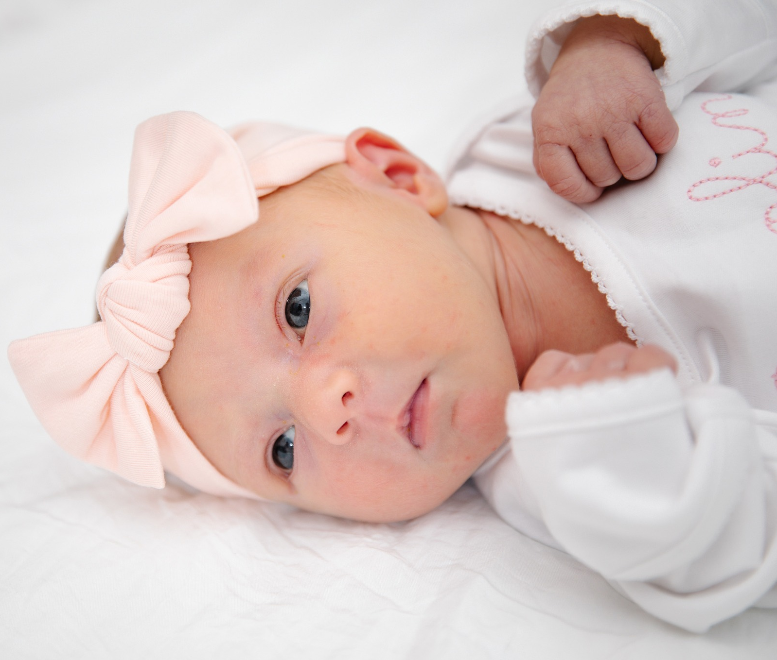

Slide 3
Beautiful Glorious

Slide 4
You are high and exalted​
Awesome and marvelous​
Boundless eternal​
Most holy One
You are excellent wise​
Magnificent wonderful​
Beautiful glorious God​

Slide 5
Lord of the Heavens
lover of my soul
The bright morning star
and our blessed hope

Slide 6
You are God of the ages
Ancient of days
And in Your presence
I stand so amazed

Slide 7
You are high and exalted
awesome and marvelous
boundless eternal
most holy One

Slide 8
You are excellent wise
magnificent wonderful
beautiful glorious God

Slide 9
Calling down thunder
shaking the earth
Your glory declared
Your infinite worth

Slide 10
You are resplendent
Your name lifted high
Grace overwhelming
And love’s sacrifice

Slide 11
You are high and exalted
awesome and marvelous
boundless eternal
most holy One

Slide 12
You are excellent wise
magnificent wonderful
beautiful glorious God

Slide 13
Strong tower
strength of my life
who calls us from darkness
to infinite light

Slide 14
You are great
and great to be praised
Yet before I was born
You called me by name

Slide 15
You are high and exalted
awesome and marvelous
boundless eternal
most holy One

Slide 16
You are excellent wise
magnificent wonderful
beautiful glorious God

Slide 17
You are high and exalted
awesome and marvelous
boundless eternal
most holy One

Slide 18
You are excellent wise
magnificent wonderful
beautiful glorious God

Slide 19
You are
beautiful glorious God…

Slide 20
DARRELL & DAWN RITCHIE

Slide 21
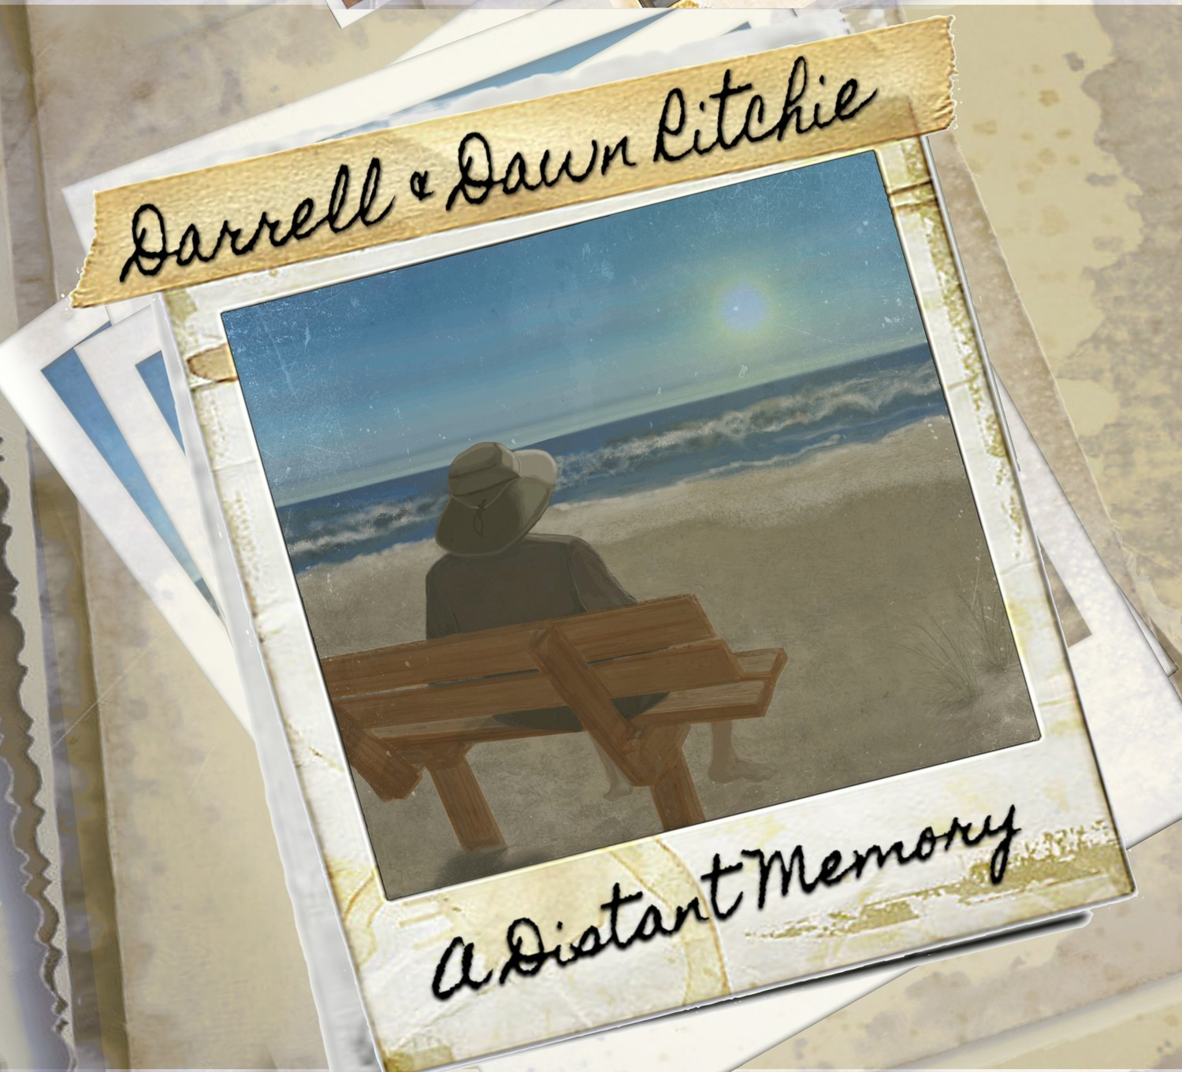

Slide 22
DARRELL & DAWN RITCHIE

Slide 23
White As Snow/ Nothing But The Blood

Slide 24
White as snow,
white as snow,
though my sins
were as scarlet,

Slide 25
Lord I know,
Lord I know,
that I'm clean
and forgiven.

Slide 26
Through the power
of Your blood,
through the wonder
of Your love

Slide 27
through faith in you
I know that I can be white as snow.

Slide 28
White as snow,
white as snow,
though my sins
were as scarlet,

Slide 29
Lord I know,
Lord I know,
that I'm clean
and forgiven.

Slide 30
Through the power
of Your blood,
through the wonder
of Your love

Slide 31
through faith in you
I know that I can be white as snow.

Slide 32
White as snow,
white as snow,
though my sins
were as scarlet,

Slide 33
Lord I know,
Lord I know,
that I'm clean
and forgiven.

Slide 34
Through the power
of Your blood,
through the wonder
of Your love

Slide 35
through faith in you
I know that I can be white as snow.

Slide 36
What can wash
away my sin? nothing but the
blood of Jesus;

Slide 37
What can make
me whole again? nothing but the
blood of Jesus.

Slide 38
Oh! precious
is the flow that makes me
white as snow;

Slide 39
No other fount I know, nothing but the
blood of Jesus.

Slide 40
This is all
my righteousness nothing but the
blood of Jesus!

Slide 41
This is all my
hope and peace nothing but the
blood of Jesus!

Slide 42
Oh! precious
is the flow that makes me
white as snow;

Slide 43
No other fount I know, nothing but the
blood of Jesus.

Slide 44
Oh! precious
is the flow that makes me
white as snow;

Slide 45
No other fount I know, nothing but the
blood of Jesus.

Slide 46
Nothing but the
blood of Jesus
nothing but the
blood of Jesus

Slide 47
DARRELL & DAWN RITCHIE

Slide 48
I Surrender All

Slide 49
All to Jesus I surrender
All to Him I freely give
I will ever love and trust Him
in His presence daily live

Slide 50
All to Jesus I surrender
Humbly at His feet I bow
Worldly pleasures
all forsaken
take me Jesus
take me now

Slide 51
I surrender all,
I surrender all
All to Thee
my blessed Savior
I surrender all

Slide 52
All to Jesus I surrender
make me Savior
wholly Thine
Fill me with
Thy love and power
truly know that
Thou art mine

Slide 53
I surrender all,
I surrender all
All to Thee
my blessed Savior
I surrender all
(x2)

Slide 54
All to Thee
my blessed Savior
I surrender all
I surrender…

Slide 55
DARRELL & DAWN RITCHIE

Slide 56
I’ll Fly Away

Slide 57
Some bright morning
when this life is over, I'll fly away
To that home on God's celestial shore I'll fly away

Slide 58
I'll fly away, oh glory I'll fly away
When I die, Hallelujah
by and by I'll fly away

Slide 59
When the shadows
of this life have gone, I'll fly away
Like a bird from prison bars have flown I'll fly away

Slide 60
I'll fly away, oh glory I'll fly away
When I die, Hallelujah
by and by I'll fly away

Slide 61
Oh, how glad and happy
when we meet, I'll fly away
No more cold iron shackles on my feet I'll fly away

Slide 62
I'll fly away, oh glory I'll fly away
When I die, Hallelujah
by and by I'll fly away

Slide 63
Just a few more weary days and then I’ll, I'll fly away
To a land where joys will never end I'll fly away

Slide 64
I'll fly away, oh glory I'll fly away
When I die, Hallelujah
by and by I'll fly away

Slide 65
When I die,
Hallelujah by and by I'll fly away…

Slide 66
DARRELL & DAWN RITCHIE

